Slide 1

COVID-19 Data Visualizations
Project 2 – Group 5
Juveriya Baig, Mark Burton, Kris wasemiller, and Jim Worlein

Slide 2
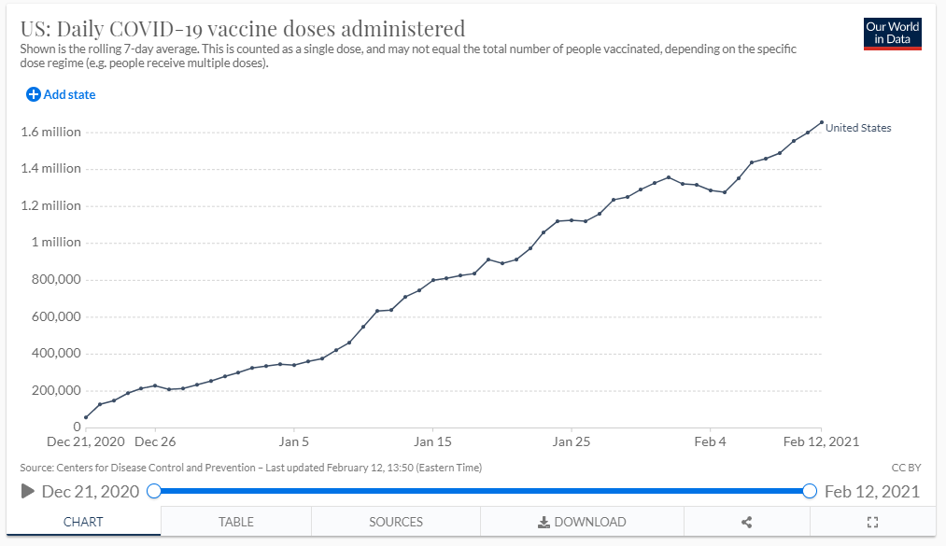
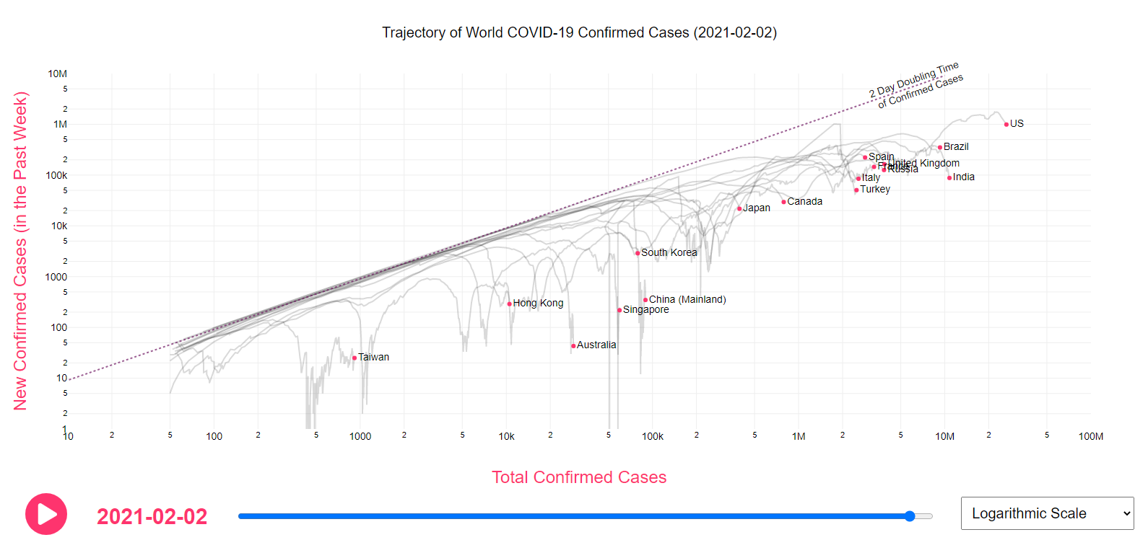
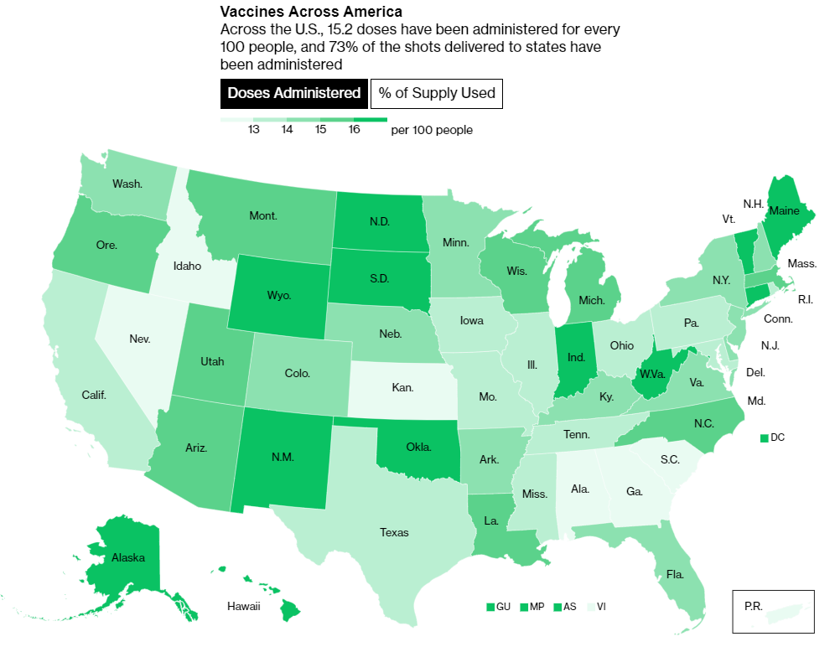
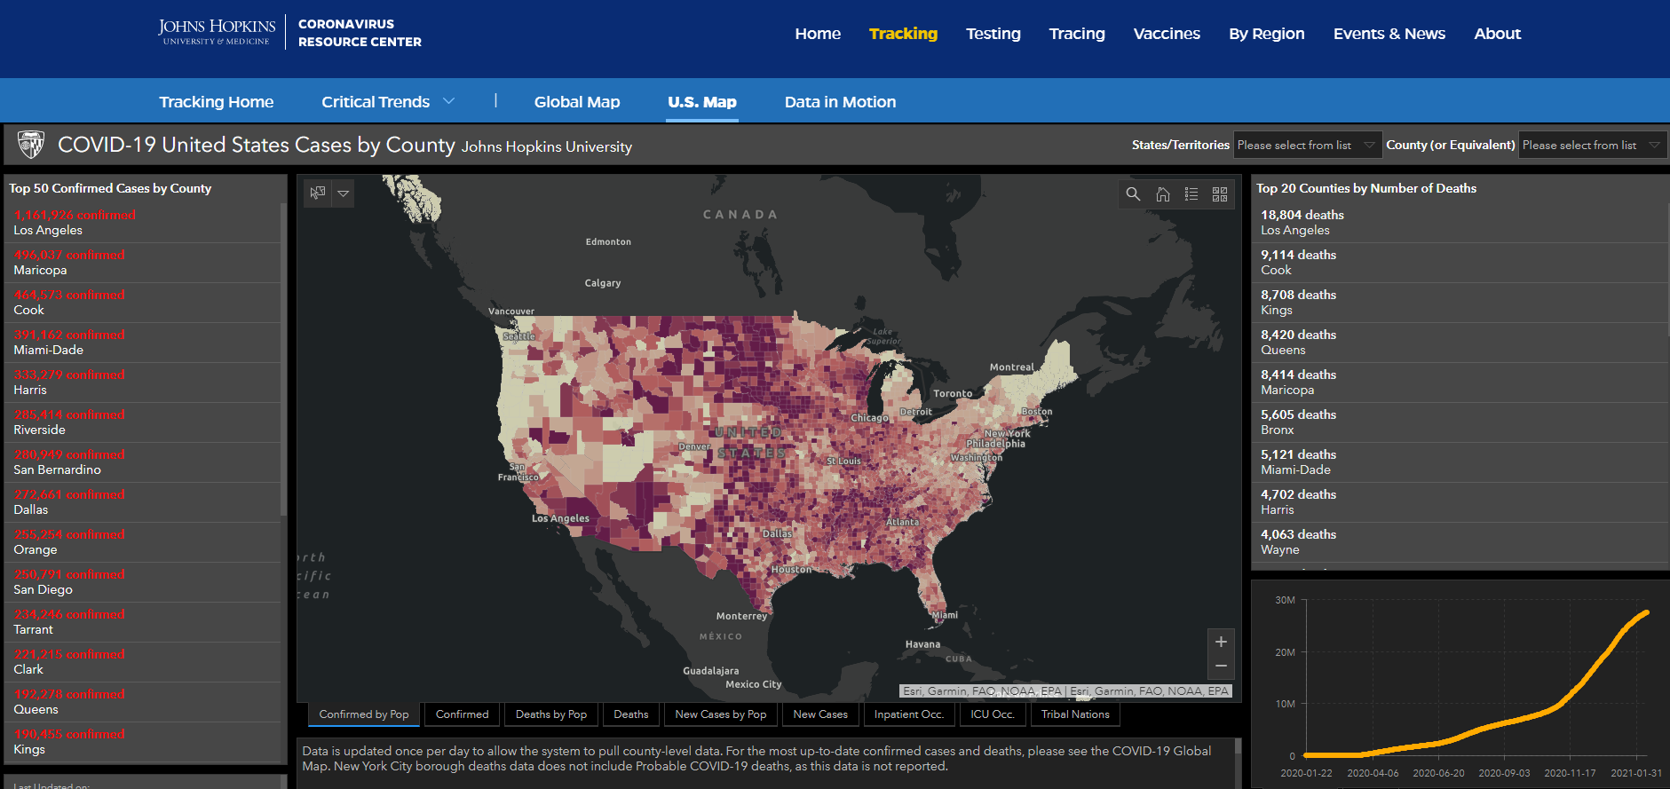
Inspirations

Slide 3
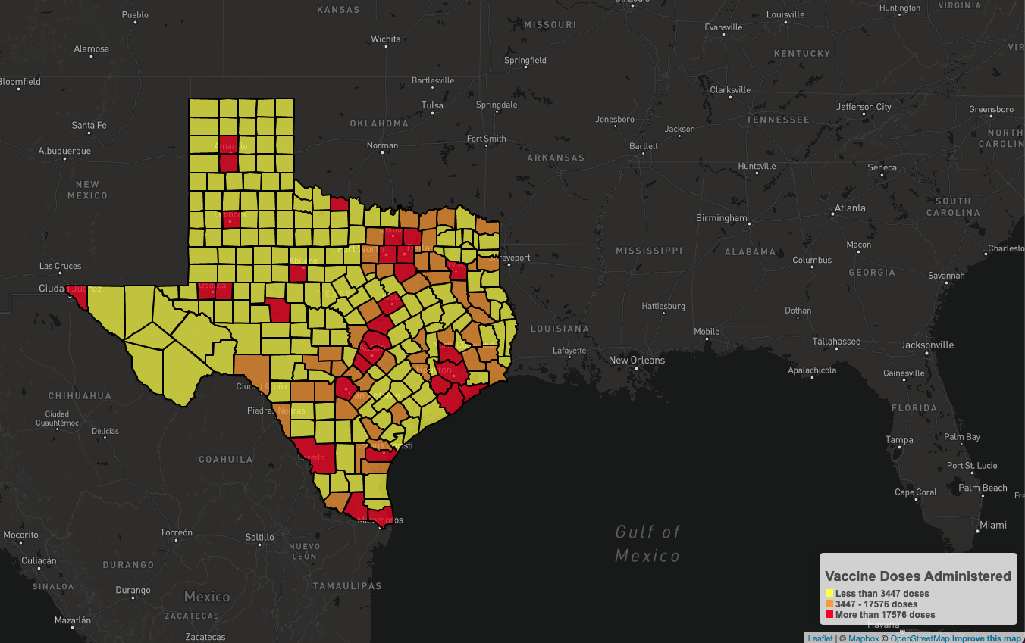
Placeholder

Slide 4
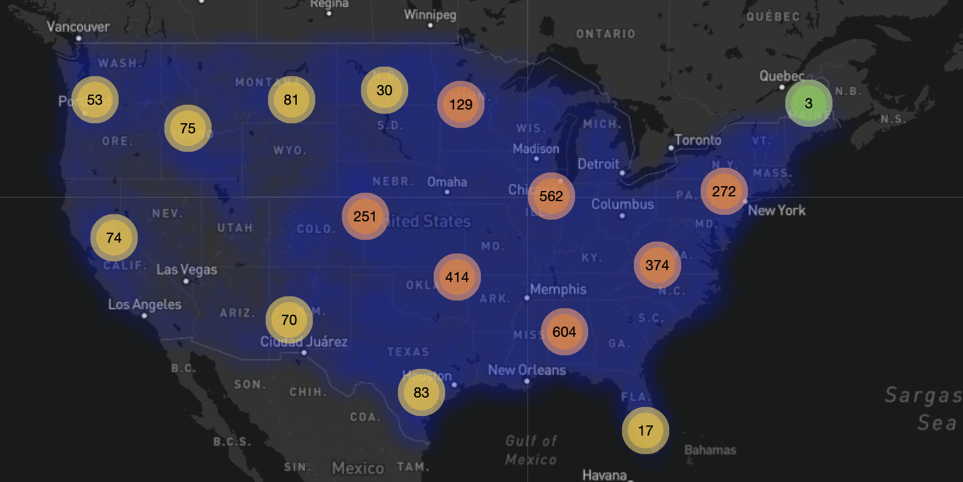
Placeholder

Slide 5
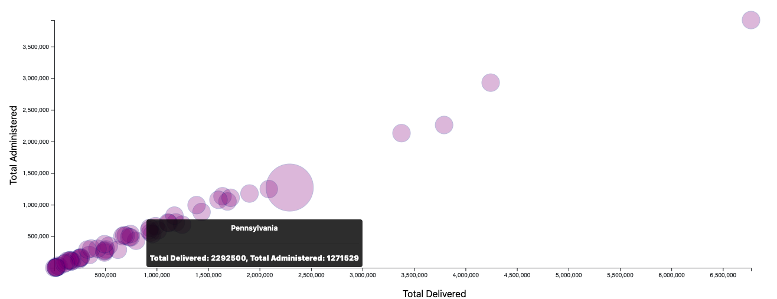
Placeholder

Slide 6
Placeholder

Slide 7
Citations
Inspirations
https://aatishb.com/covidtrends/
https://www.bloomberg.com/graphics/covid-vaccine-tracker-global-distribution/
https://ourworldindata.org/us-states-vaccinations
https://coronavirus.jhu.edu/us-map
Visualizations
placeholder

